Slide 1


Energy efficient Bayesian synapses
James Malkin¹, Cian O’Donnell², Conor Houghton¹, Laurence Aitchison¹
James Malkin
Intelligent Systems Laboratory, School of Computer Science, Electrical and Electronic Engineering, University of Bristol, Bristol, UK
Intelligent Systems Research Centre, School of Computer Science, Engineering and Intelligent Systems, Ulster University, Derry/Londonderry, UK 2.

Slide 2
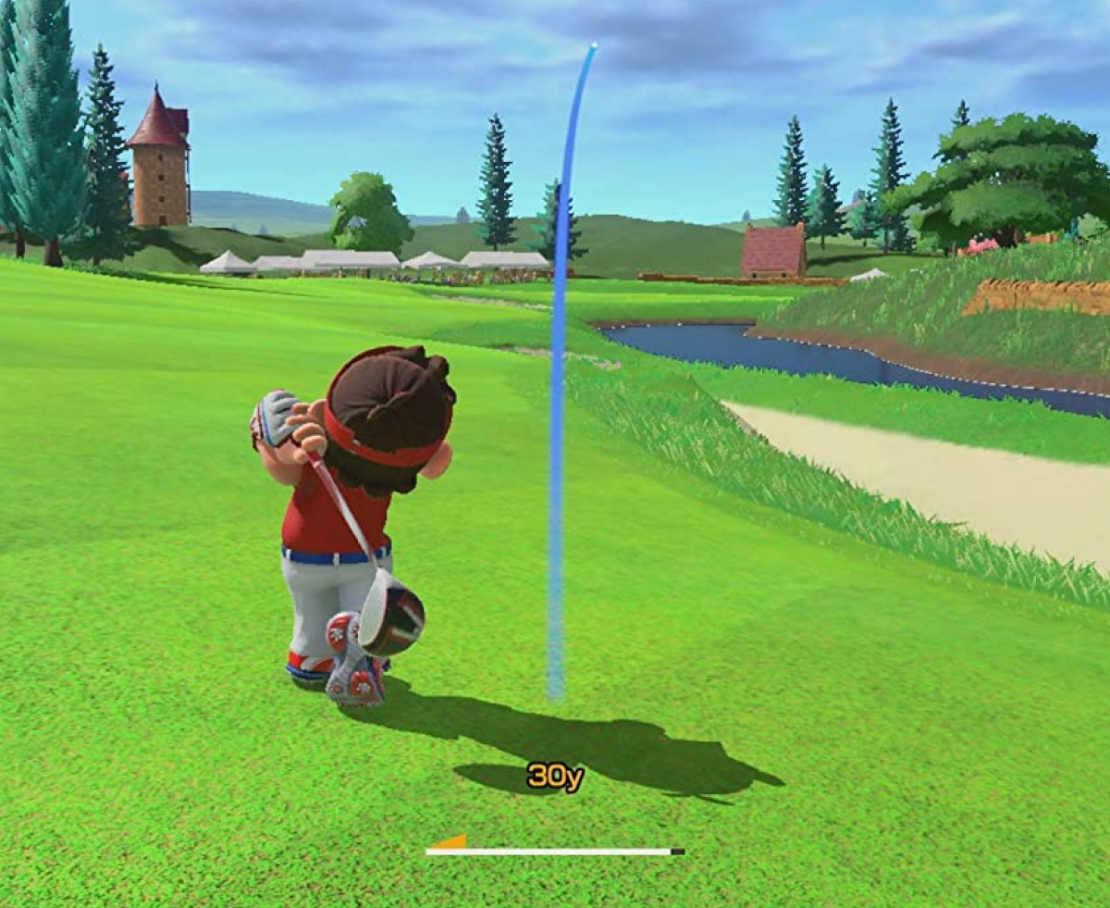

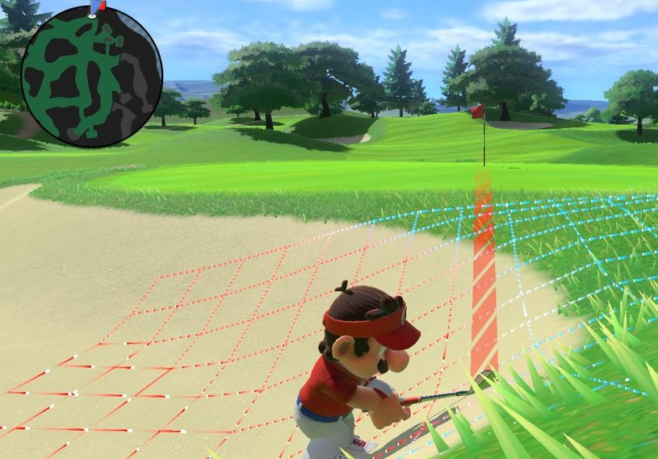
Context – learning
Goal: Maximise performance
Strategy: Infer synapse settings that generate output with minimal error
Problem: Lack of observation range (or suboptimal model)
An example classification task: Choose club type based on surface and distance from hole
Notes:
Think of learning as minimizing error
Minimize the error of the brain’s model of its environment
Find model that is most evidenced by environment

Slide 3
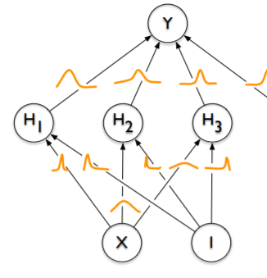
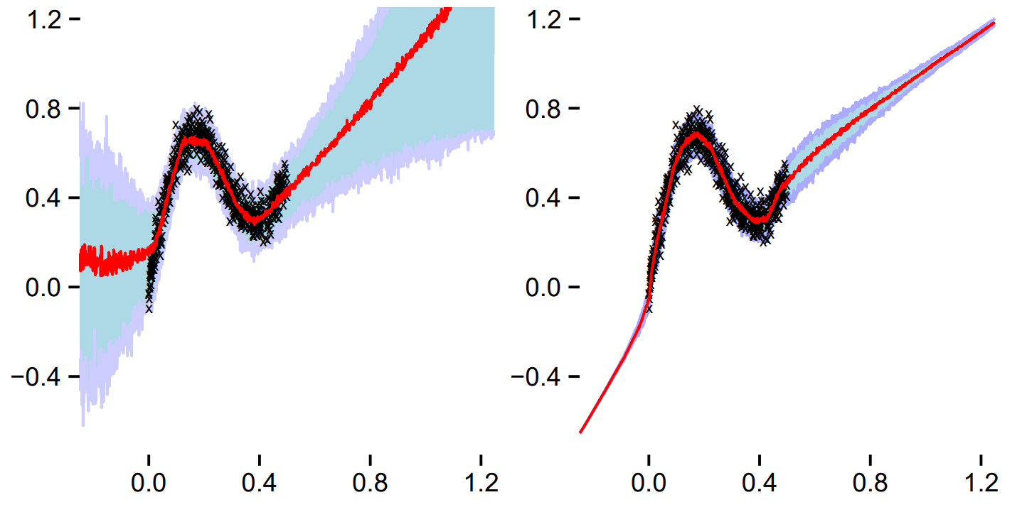
Solution - Bayesian model uncertainty
Regular neural networks can only express aleatoric uncertainty
Bayesian neural networks can express both aleatoric uncertainty and epistemic uncertainty
Bayesian network E[P(D|w)]
Standard network P(D|w)
Bayesian network
Regression of noisy data with interquartile ranges. Black crosses are training samples. Red lines are median predictions. Blue/purple region is interquartile range.
Blundell and Wiestra et al, 2015

Slide 4
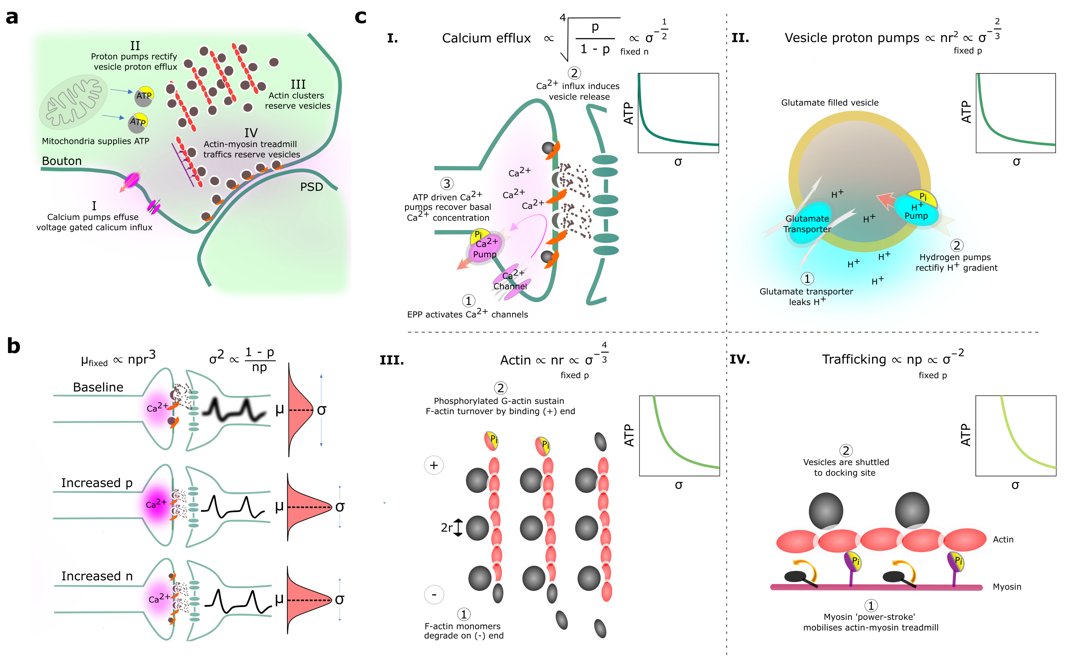
Project rationale
Bayesian synapses can express uncertainty; however, stochastic synapses invoke unreliability which can be detrimental to performance.
We consider the synaptic design that emerges from an evolutionary imperative to balance performance and energy sparsity.
Binomial quantal model
Costly physiological processes

Slide 5
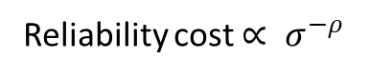
Reliability costs – power laws of precision
Reliability cost $∝ σ^{−ρ}$

Slide 6
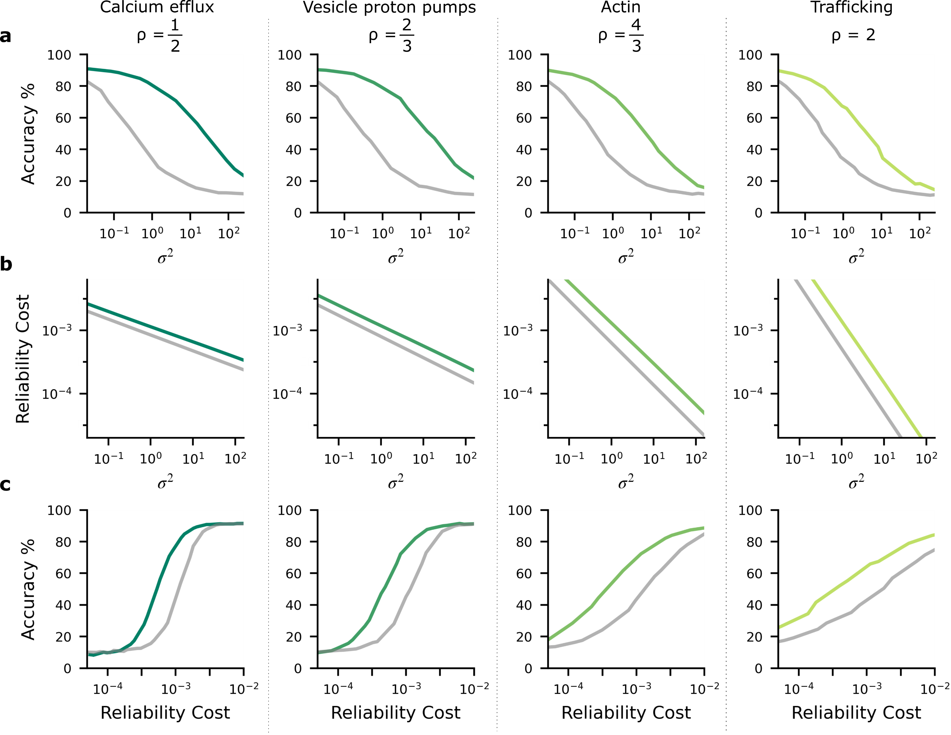
The performance-reliability cost tradeoff

Slide 7
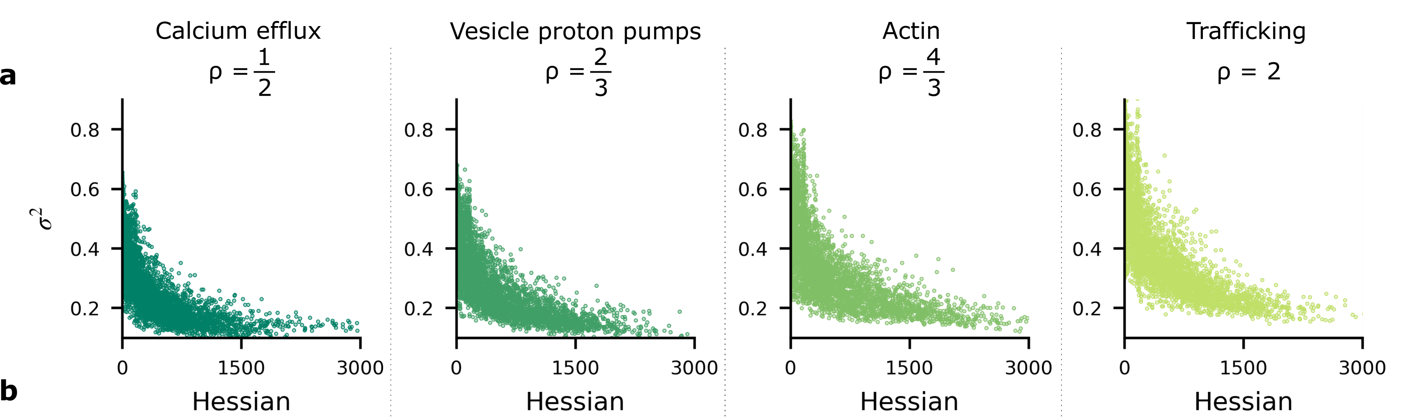
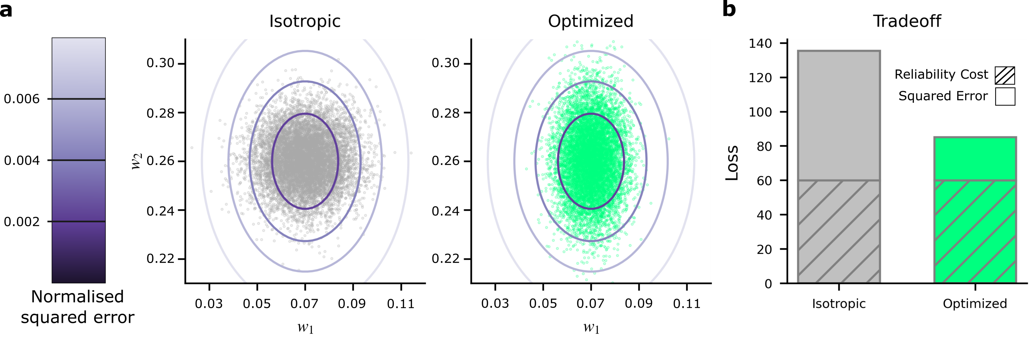
Synapse noise mirrors a Gaussian approximated Bayes posterior
Synapse noise is associated with the Hessian or Fisher’s information of the likelihood
The tradeoff optimizes synapse noise by minimizing both the covariance of the MMSE estimate and the reliability cost

Slide 8
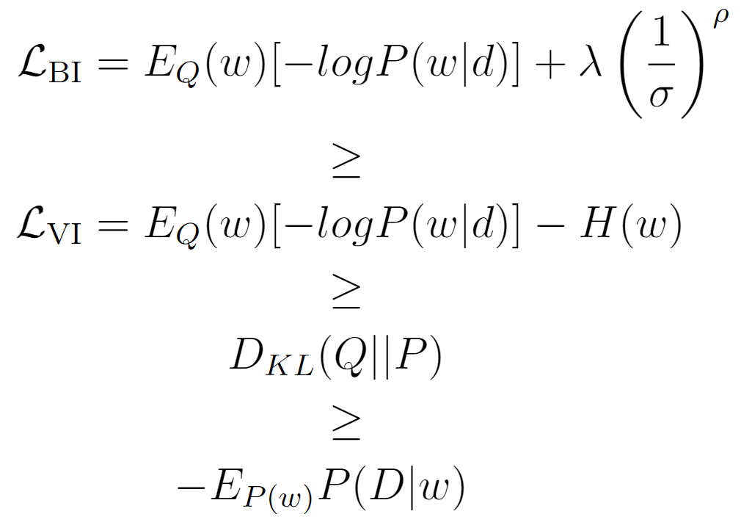
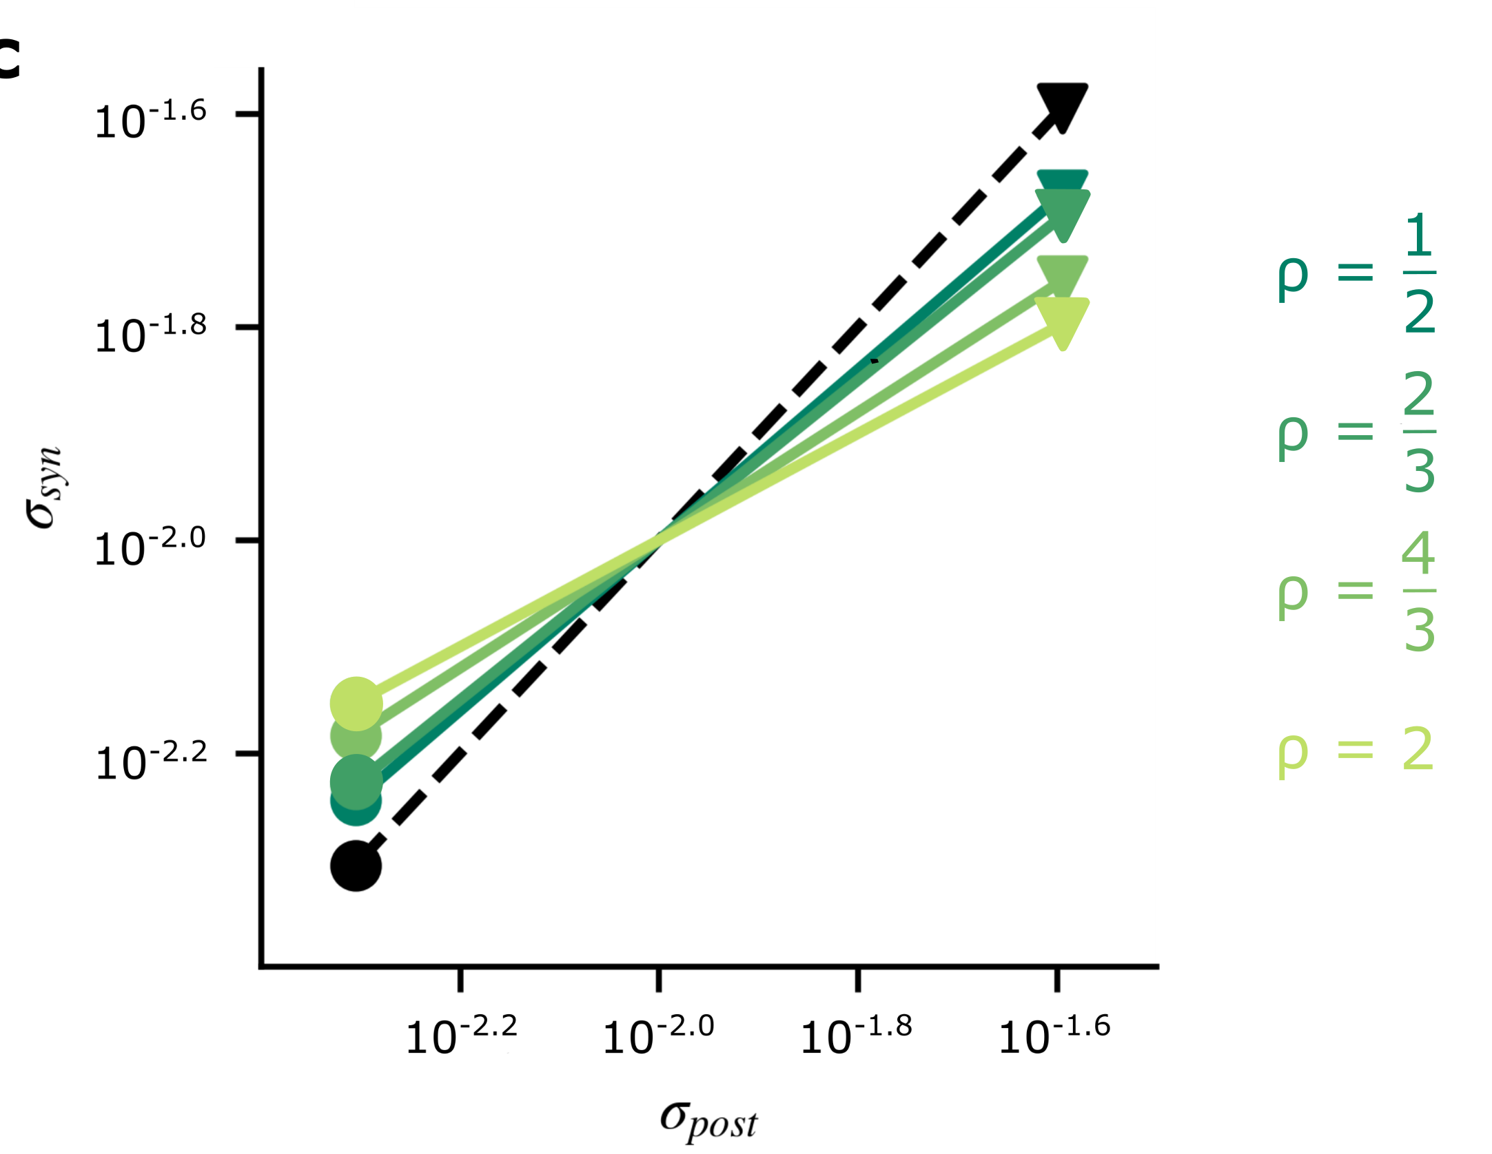
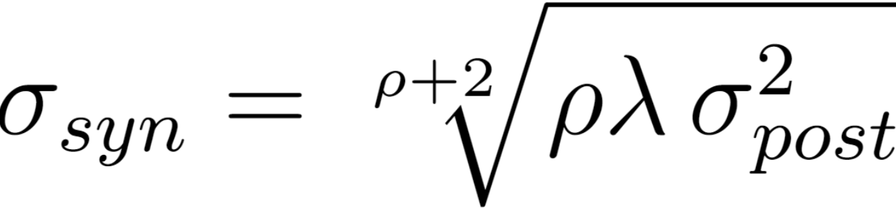
Why?
The tradeoff bounds the variational inference objective
For particular λ or if ρ tends to zero, L_{BI} and L_{VI} share the same bound:
As ρ tends to zero, synapse noise aligns with the Bayesian variance, in fact

Slide 9
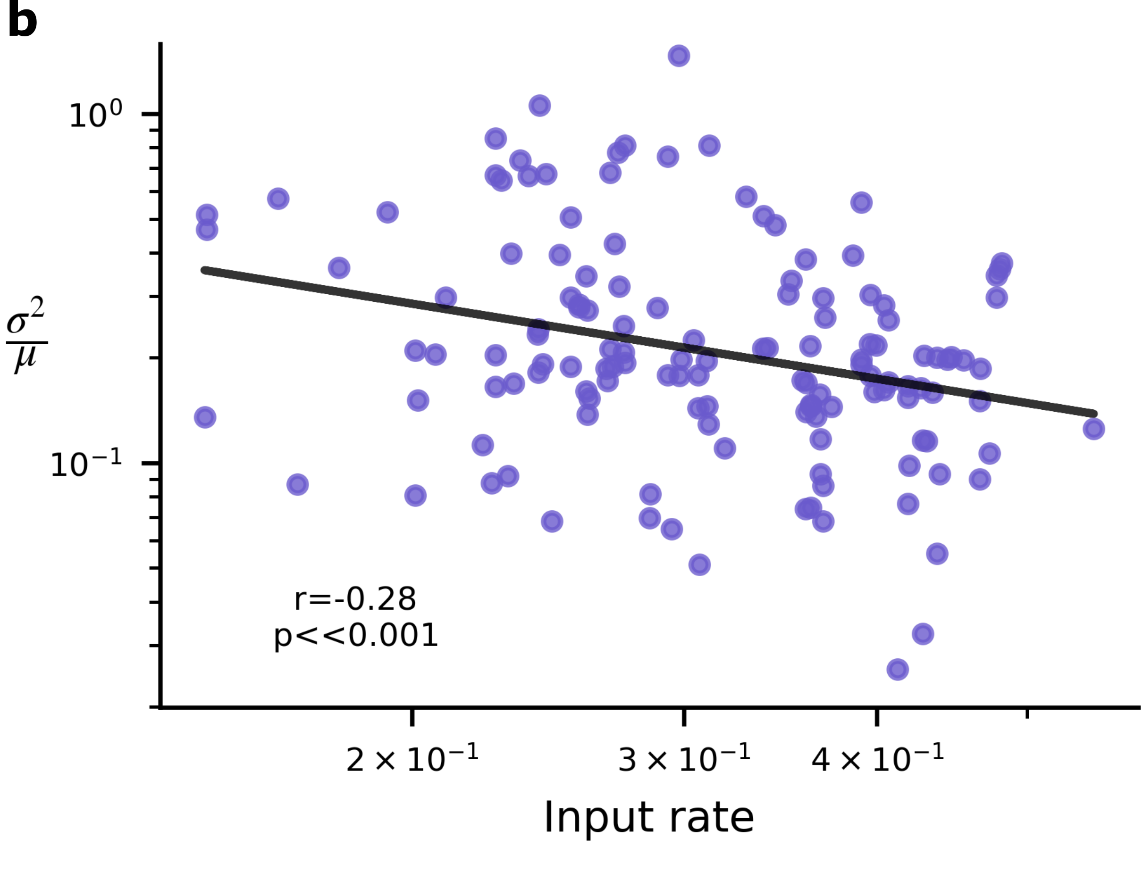

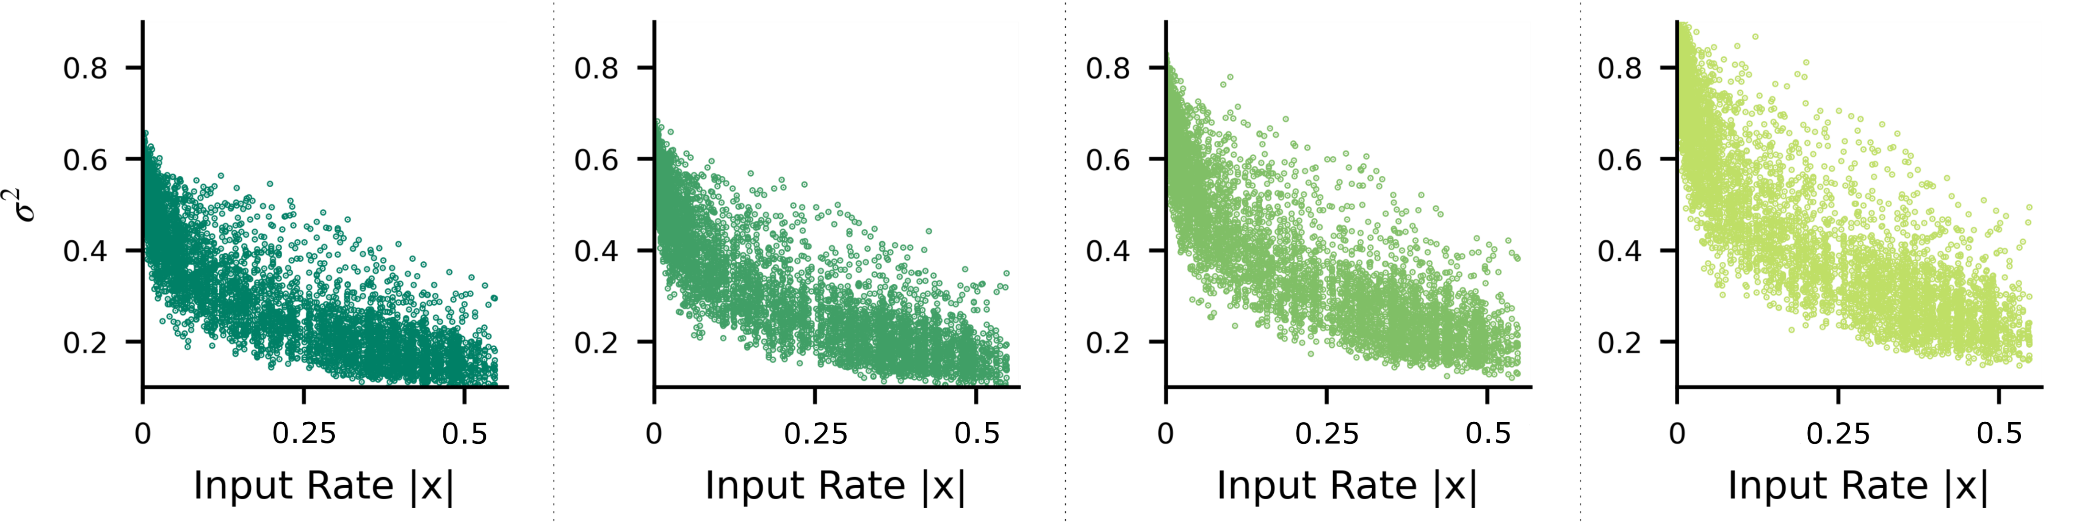
Are biological synapses Bayesian?
There is evidence that synapse post synaptic potential (PSP) noise is Bayesian.
Negative correlation between input rate and variance, shared with synapses simulated under the tradeoff:

Slide 10

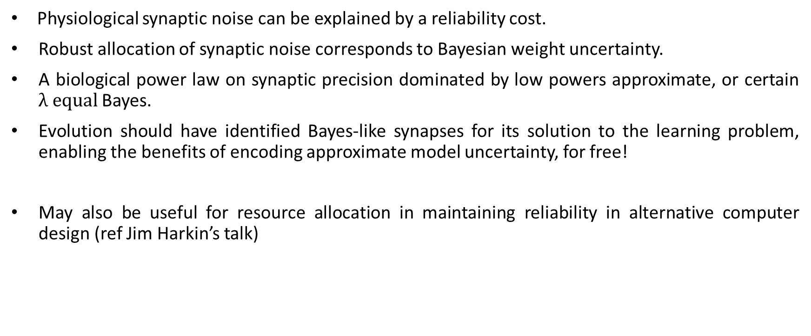
Summary
Physiological synaptic noise can be explained by a reliability cost.
Robust allocation of synaptic noise corresponds to Bayesian weight uncertainty.
A biological power law on synaptic precision dominated by low powers approximate, or certain $λ equal$ Bayes.
Evolution should have identified Bayes-like synapses for its solution to the learning problem, enabling the benefits of encoding approximate model uncertainty, for free!
May also be useful for resource allocation in maintaining reliability in alternative computer design (ref Jim Harkin’s talk)

